Slide 1

3 Business Strategies in International contexts ^{Prof. Dr. Geoffrey Ditta} ^{Complutense UNIVERSITY}

Slide 2
The development of internationalization strategies
Internationalization is emerging as one of the drivers of trade development, as local companies with the resources to internationalize their activities offer themselves significant opportunities for economic growth

Slide 3
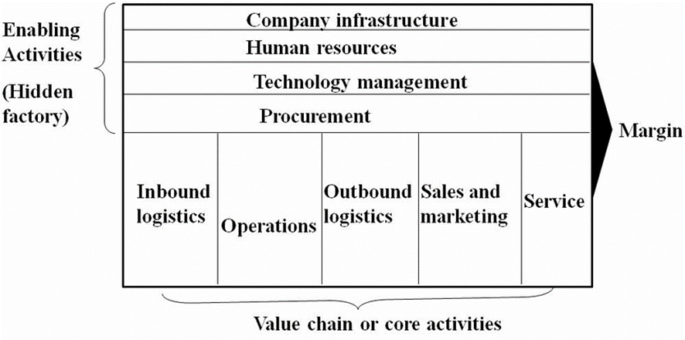
Internationalization Vs Amount at Stake
Phase 1 Conceive (C)
Phase 2 Develop (D)
Phase 3 Execute (E)
Phase 4 Finish (F)
Increasing Risk
$ Value
Combined risk impact
Amount at stake
Time

Slide 4
International SWOT Analysis
Personnel speaks languages & open minded
Strenght
Opportunity
Weakness
Threat
Few competitors in target market
Participated in international Business
Free trade agreement with destination country
Informed about foreign markets
Target country with high demand or high population
Distance to main ports
High level of competitors in target market
Lack of education of personnel
High import taxes and duties of my product
Poor coordination between departments
Excesive burocracy at destination
Notes:
El análisis interno y externo que hemos realizado nos llevará a entender las áreas que tenemos que fortalecer para poder desarrollar el proyecto, las fortalezas en las que nos apoyaremos y lo mismo con los factores externos. Es importante empezar la inmersión en países donde las oportunidades sean mayores que las amenazas, para reducir riesgos, especialmente en las primeras experiencias.

Slide 5
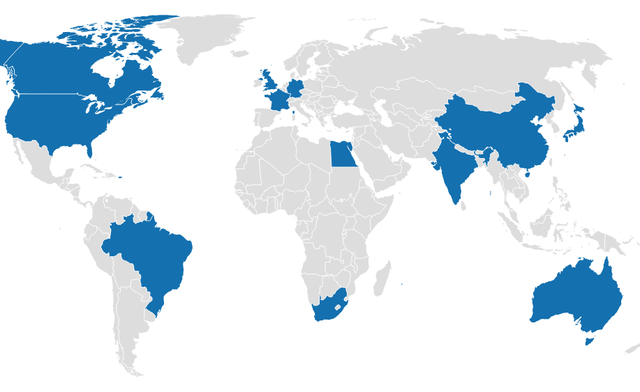
International Business Simulation: Market Entry - Overview
In the Market Entry simulation, you are in charge of managing the international strategy and operations. You manage all of the company’s business outside your home country.
After choosing a home country, review the country information and news for the year before making decisions on:
Countries to enter, grow or exit
Entry Modes
Local Marketing decisions

Slide 6
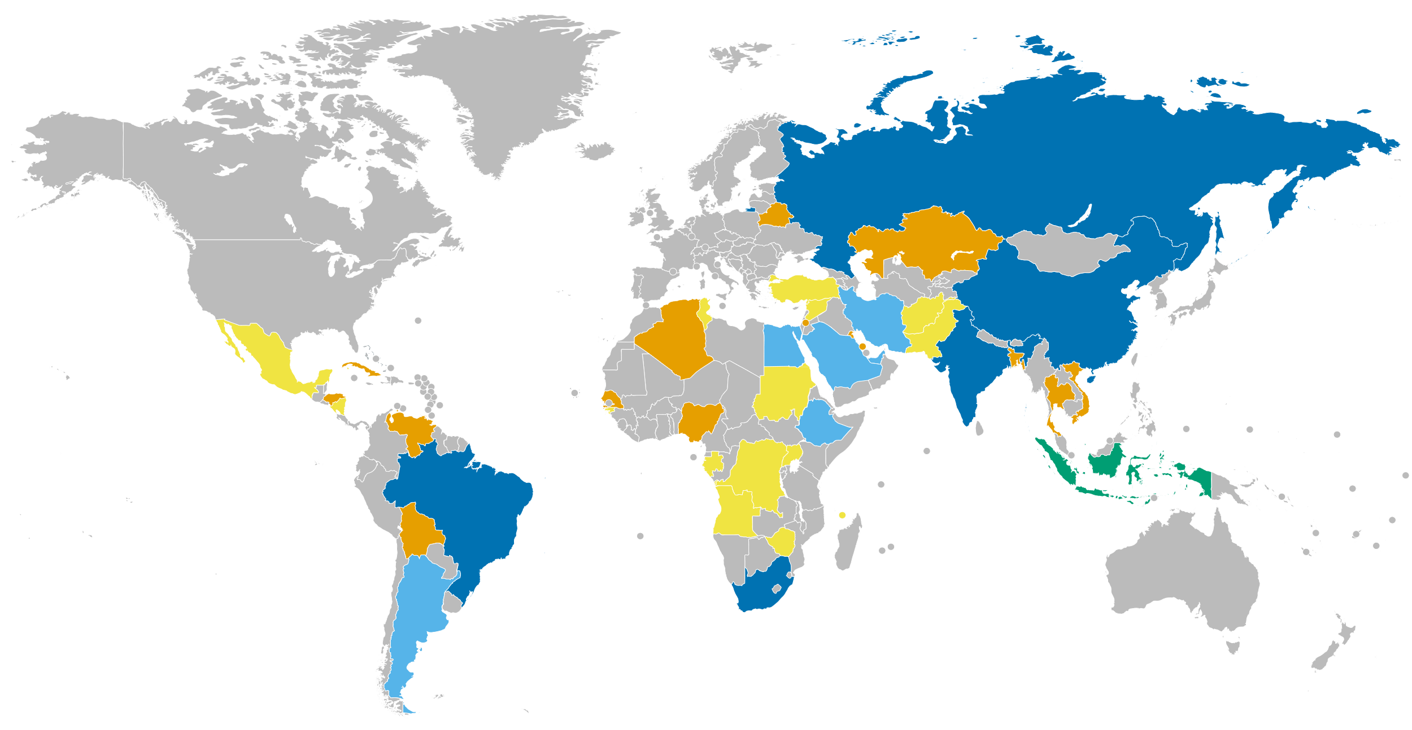
Where to expand

Slide 7
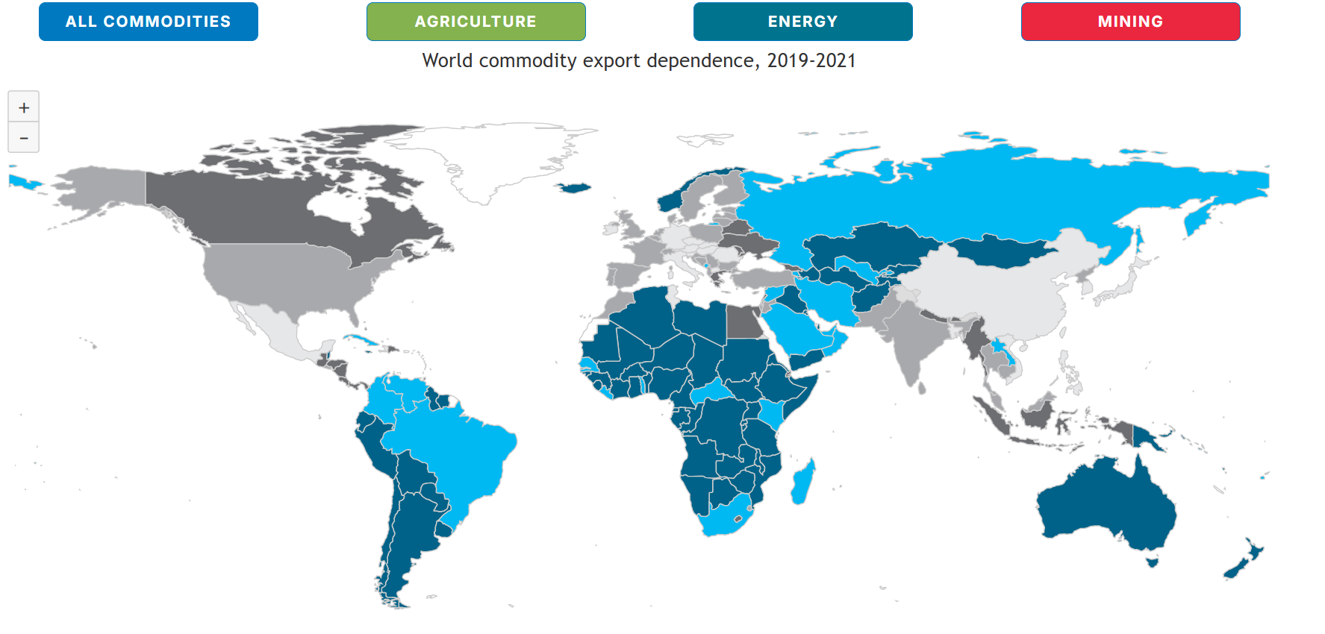
Reasons to expand
https://unctad.org/topic/commodities/state-of-commodity-dependence

Slide 8
Creating a Project Organization
Define who is going to do what
Define roles and responsibilities
Identify people and resources, ensure their commitment to the project
Identify a project leader, specify their authority and responsibilities
Important questions:
Who is the project manager? What decisions are within the PM’s area of authority? Is this authority sufficient to carry out the project?
Who is on the team? Fulltime or part-time? What are their areas of expertise? Their roles?
Who is the project sponsor? Are they at a sufficiently high level in the organization to provide the project with the support it needs to have a good chance of success?
Create your own organization. 5 departments, finance, marketing, accounting, production … . 20 employees

Slide 9
Master the impact of the most frequent business decisions on the 3 financial statements of a company: Income Statement, Balance sheet, Cash flow statement
Build up and use a comprehensive set of financial performance indicators to assess and improve a company’s performance
Make decisions to optimize cash generation

Slide 10
The potential size of each market depends on:
The market growth rate expected in each industry
The economy (Business index)
The prices offered by the different competing companies
The quantities of products available for sale
The administrative & selling expenses, i.e. sales & marketing efforts
The Research & Development expenses to create product appeal
A
+10% yearly
B
-5% yearly

Slide 11
Decisions at business unit and CEO levels
HR & Quality
Financing
CEO
A
B
Production
Pricing
Adm. & Selling
R&D
Facility investment
Production
Pricing
Adm. & Selling
R&D
Facility investment

Slide 12

Research and development
Research & Development relates to
Improving the product attractiveness to customers (intrinsic features)
Decreasing the manufacturing costs: “design-to-cost” & “design for manufacturability”
Money invested in R&D has both
An immediate effect
A cumulative effect

Slide 13
Human resources and quality
HR & Quality relates to
People – Selection, Training, Career Development Plan...
Tools – IT & Telecom
It has a positive impact on Employee Morale by improving employee’s confidence in their company
It improves effectiveness of all business processes, thus enhancing the effectiveness of
Marketing
Research & Development
Production
Money spent in HR & Quality takes one period to be effective

